Slide 1

Everything you need to know about SGX
FNCE6006-G1-Financial Econometrics
Group 10: Wengwei, Cao Danyang, Ma Tianqi, Luo Hao, Liu Qinglin

Slide 2
By Sector Analysis

Slide 3
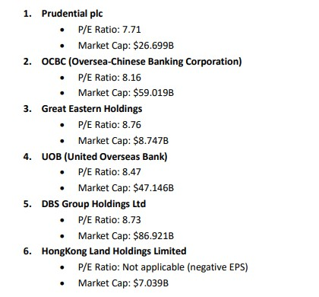
Finance Sector
Analysis based on P/E ratio and market cap
Prudential plc - Lowest P/E ratio among the listed, indicating potential undervaluation, combined with a significant market cap.
DBS Group Holdings Ltd - Although its P/E ratio is slightly higher than Prudential's, its market cap is the largest, indicating strong market presence.
UOB - Moderate P/E ratio and substantial market cap, indicating good stability and fair valuation.
Great Eastern Holdings - Higher P/E ratio compared to others, but still under 9, with a decent market cap.
HongKong Land Holdings Limited - Data on P/E ratio is not applicable due to negative EPS, indicating potential financial distress or other factors affecting earnings negatively, combined with the smallest market cap among those listed.

Slide 4
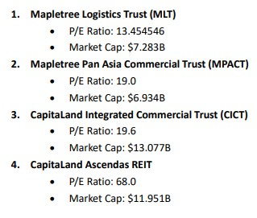
Real Estate Sector
Analysis based on P/E ratio and market cap
Mapletree Logistics Trust (MLT) - Offers the lowest P/E ratio among the listed, indicating potentially better value per earnings, combined with a substantial market cap.
Mapletree Pan Asia Commercial Trust (MPACT) - Second-lowest P/E ratio, suggesting reasonable valuation, though it has the smallest market cap among the group, indicating a slightly riskier investment.
CapitaLand Integrated Commercial Trust (CICT) - Similar to MPACT in terms of P/E ratio but possesses the highest market cap, indicating a larger and possibly more stable company.
CapitaLand Ascendas REIT - Highest P/E ratio among the group, suggesting it might be overvalued compared to the others, despite having a significant market cap.

Slide 5
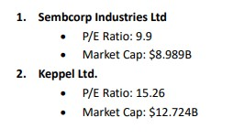
Oil & Gas Sector
Analysis based on P/E ratio and market cap
These two companies offer distinct investment profiles based on their P/E ratios and market capitalizations. Sembcorp Industries, with its lower P/E ratio, suggests a potentially more attractive valuation compared to Keppel Ltd., which has a higher P/E ratio but also a larger market cap, indicating it may be considered a larger and possibly more stable company.

Slide 6
Singapore Airline
P/E Ratio (TTM): 11.12 - This figure is relatively moderate, indicating that the stock might be reasonably valued compared to its earnings. A P/E ratio in this range suggests that the company's stock price is in line with what it earns, which could be seen as a positive sign for investors looking for potentially stable investments.
Market Cap: $18.857B - The substantial market capitalization of Singapore Airlines signifies its large size and the considerable value placed on it by the market. Large-cap companies like Singapore Airlines are generally considered to be more stable and less volatile than smaller companies, which can make them appealing to investors seeking lower-risk investments.
Dividend Yield: 5.96% - A high dividend yield can be attractive to investors looking for regular income from their investments. Singapore Airlines' dividend yield suggests it returns a significant amount of value to its shareholders in the form of dividends, which can be a positive factor for income-focused investors.
Financial Health and Growth Prospects: The Company has a balance of cash and debt that indicates a solid financial position, with total cash of $14.217 billion and total debt of $14.662 billion. The positive earnings growth and revenue growth indicate potential for future expansion and profitability.

Slide 7
Reflections
After analyzing the key sectors of the Singapore stock market from the perspectives of P/E Ratio and Market Capitalization, we conclude that beyond the conventional realms of Finance and Real Estate investments, the Petrochemical sector and Singapore Airlines equally merit investment consideration.
This leads us to our subsequent research focus, which entails an in-depth analysis of dividend distributions pertaining to the three major local banking stocks: DBS, OCBC and UOB.

Slide 8
Further Insight on Bank Stocks

Slide 9
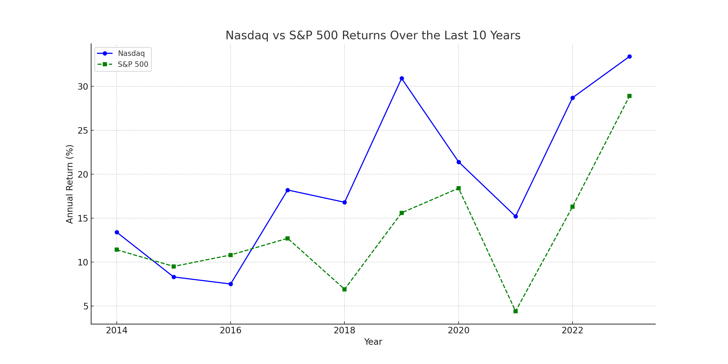
Overall Performance
Historically, the Nasdaq 100 has outperformed the S&P 500 in terms of long-term returns, partly due to the significant growth in technology stocks.

Slide 10
Cross Hedge
Increased hedging opportunities: Cross hedging allows investors to hedge against risks even when direct hedging instruments for the specific asset are not available or are limited. This broadens the range of assets that can be effectively hedged.
Cost-effectiveness: In situations where direct hedging instruments are either unavailable or too expensive, cross hedging can offer a more cost-effective alternative. By using related assets with similar risk exposures, investors can achieve a similar level of risk reduction at a lower cost.
Diversification: Cross hedging can contribute to portfolio diversification by introducing assets from different markets or sectors. This can help spread risk across a broader range of investments and reduce the overall volatility of the portfolio.

Slide 11
Cross Hedge
Increased liquidity: In some cases, the hedging instruments used for cross hedging may be more liquid and actively traded than the direct hedging instruments for the target asset. This can provide greater liquidity and ease of trading, reducing transaction costs and improving market access.
Flexibility: Cross hedging allows investors to tailor their hedging strategies to their specific risk exposures and investment objectives. By selecting alternative assets with similar risk characteristics, investors can customize their hedging positions to better match their portfolio needs.

Slide 12
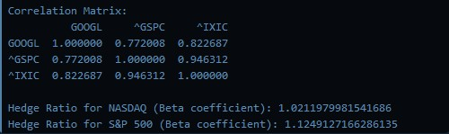
Solution
To begin with, we applied 3-year historical data to obtain the hedge ratio of Nasdaq and S&P 500 against Google Stock.
Hedge Ratio for NASDAQ (Beta coefficient): 1.0211979981541686
Hedge Ratio for S&P 500 (Beta coefficient): 1.1249127166286135
Base on the beta coefficient, our strategy is to buy 690 Google stocks, short 6 Nasdaq and 16 S&P 500 respectively.

Slide 13
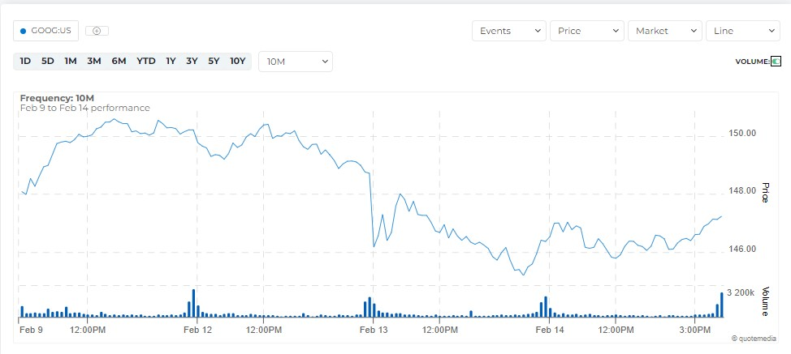
Results
Symbol | Description | Quantity | Currency | LastPrice | PricePaid | DayChange | ProfitLoss | MarketValue | ProfitLossPercentage
GOOG | Alphabet Inc - Ordinary Shares - Class C | 690 | USD | 147.14 | 146.2 | 0.77 | 874.24 | 136846.5604 | 0.64
ES/H4 | SP-MIN MAR 14 | -16 | USD | 5027 | 4991.96875 | 9.5 | -37,774.58 | 5420669.335 | -0.7
NQ/H4 | E-mini Nasdaq-100 Futures MAR 24 | -6 | USD | 17920 | 17739 | 46.5 | -29,276.14 | 2898499.935 | -1.02

Slide 14
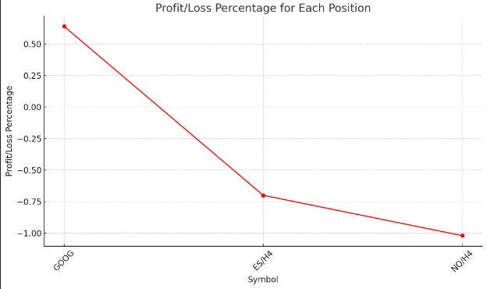
Hedging Effectiveness
NASDAQ's Hedge Ratio is closer to 1, suggesting that it may provide a slightly more precise hedge against the Google position, as it indicates a closer movement with Google stocks on a relative basis.
S&P 500's Hedge Ratio is higher, indicating a need for more futures to hedge the same position, which may imply a slightly less efficient hedge in terms of volatility matching but could be beneficial if the S&P 500 futures exhibit less volatility or the portfolio manager expects the S&P 500 to align better with Google's future price movements.

Slide 15
Analysis on REITs

Slide 16
Cost Efficiency
Symbol | Description | Quantity | Currency | LastPrice | PricePaid | DayChange | ProfitLoss | MarketValue | ProfitLossPercentage
GOOG | Alphabet Inc - Ordinary Shares - Class C | 690 | USD | 147.14 | 146.2 | 0.77 | 874.24 | 136846.5604 | 0.64
ES/H4 | SP-MIN MAR 14 | -16 | USD | 5027 | 4991.96875 | 9.5 | -37,774.58 | 5420669.335 | -0.7
NQ/H4 | E-mini Nasdaq-100 Futures MAR 24 | -6 | USD | 17920 | 17739 | 46.5 | -29,276.14 | 2898499.935 | -1.02
S&P 500 Futures: Given their high market value and the negative profit/loss, this position seems to have been less cost-efficient recently, possibly due to the large size of each contract and the broad diversity of the S&P 500 index.
NASDAQ Futures: With a smaller absolute market value and profit/loss, these would be more cost-efficient for hedging a tech-heavy portfolio, given their lower cost and closer correlation to Google.

Slide 17
Optimal Index Future Selection
If the primary goal is to closely match Google's movements and manage cost, NASDAQ futures would be the preferable choice due to their closer hedge ratio and potentially lower costs associated with smaller contract sizes.
However, judging from the results, the performance of both options in hedging against Google is hardly satisfactory, which leads to the second part of our project.

Slide 18
Portfolio & Index Futures

Slide 19

Rationale of Strategy
Diversification
Portfolio spreads risk; single stocks are more volatile.
Risk Hedging
Index futures mitigate market risk, not specific stock risk.
Beta
Diversified portfolios' beta closer to 1; single stocks vary greatly.
Cost Efficiency
Portfolio hedging requires fewer adjustments, reducing costs.

Slide 20
Rationale of Stocks chosen
AAPL | Strong innovation, financial health, and favorable macro environment
AMZN | Strong growth, solid fundamentals, and favorable macro trends
GOOGL | Strong AI focus, robust financials, and positive macro trends
META | Strong AI focus and financials
MSFT | Strong AI focus, financial health, and market outperformance
BRK-A | maintains a positive free cash flow in Q2 and Q3 of 2023, indicating operational strength.
JNJ | recent strategic moves, including acquisitions and legal settlements,is positive for long-term growth.
JPM | Strong performance, strategic growth, and positive outlook
PG | outperformed expectations in its Q2 fiscal 2024 earnings
XOM | Strong fundamentals and strategic growth initiatives

Slide 21
Correlation with Index
 | AAPL | AMZN | GOOGL | META | MSFT | BRK-A | JNJ | JPM | PG | XOM
Nasdaq-100 | 0.755888 | 0.716652 | 0.700929 | 0.687301 | 0.724760 | 0.436845 | 0.075544 | 0.373616 | 0.168269 | 0.048097
S&P 500 | 0.708601 | 0.599266 | 0.604359 | 0.590105 | 0.616949 | 0.602066 | 0.231504 | 0.536233 | 0.288816 | 0.254820

Slide 22





Stock Portfolio
Company | AAPL | AMZN | GOOGL | META | MSFT
Logo
Price | 184.15 | 170.98 | 145.94 | 473.28 | 409.49
Value | 60,000 | 60,000 | 60,000 | 60,000 | 60,000
Total Value | 300,000

Slide 23
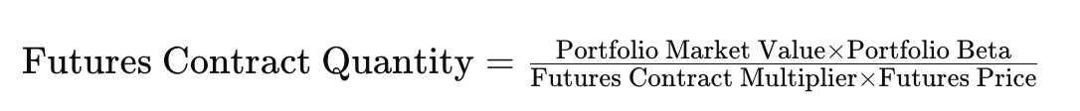
Details of Strategy
Portfolio Value | 300,000
Portfolio Beta to NASDAQ | 1.4302
Portfolio Beta to S&P 500 | 1.2343
 | NASDAQ | S&P 500
Price | 17912.75 | 5024.5
Multiplier | 20 | 50
No. of Contracts Purchased | 2 | 2

Slide 24
Results
Future/Portfolio | Profit/Loss at Feb 15 2024
Portfolio | $25,067
e-Mini Nasdaq 100 | -$15,073.5
Net Profit/Loss | $9993.5 （2.976%）
Reflections
Market Uplift: Portfolio gains from well-performing sectors.
Exceeding Expectations: Price surge in META and others post-positive reports.
Macroeconomic Boost: Interest and inflation rates drop, economic outlook brightens.
Futures Volatility: Market trends and demand affect futures pricing, impacting shorts.
Future/Portfolio | Profit/Loss at Feb 15 2024
Portfolio | $25,067
e-Mini S&P 500 | -$28,660.4
Net Profit/Loss | -$3593 (-1.158%)

Slide 25
THANKS FOR LISTENING
FNCE6060-G1-Math of Fixed Inc & Der Securities
MEMBER: Liu Qinglin, Ruan Qinwen, Sai Rohit

